Slide 1


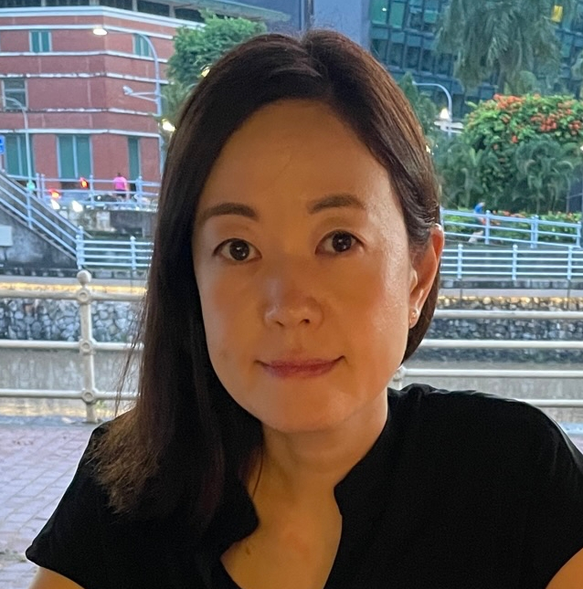

TOMOWORK GOAL SETTING WORKSHEET
NAME
INSTITUTE
GOAL START DATE
20 MARCH 2023
GOAL COMPLETION DATE
1 JUNE 2023
MY CAREER GOAL IN 2 YEARS
WORK
LEARNING
ACTIVITIES
5 THINGS I WANT TO ACHIEVE FROM TAP (Please include more than 1 soft skills)
ACTION THAT WILL HELP ME TO REACH MY GOAL
REVIEW
(REVIEW BY 31 MAY MORNING)
1
2
3
4
5
1
2
3
4
5
1
2
3
4
5
COMMENTS FROM FACILITATORS

